Slide 1

Blog Generation with LLaMA 2 and Streamlit: Automating Content Creation
This presentation explores a project that leverages the power of LLaMA 2 and Streamlit to automate the process of generating blog content, offering a convenient solution for content creators and marketers.
by TEAM EXTRINOS

Slide 2
Introduction to LLaMA 2
Meta's LLaMA 2
Key Features
Advantages
Open Source License
Meta's open-source large language model for text generation.
7B, 13B, and 70B parameter models trained on 2 trillion tokens of publicly available data.
Improved reasoning, coding, proficiency, and knowledge compared to LLaMA 1.
Encourages research, development, and commercial use.

Slide 3

Streamlit: The Interactive Web Framework
1
Streamlit is a Python framework for rapidly building interactive web applications.
2
Streamlit offers a simple API, hot-reloading, and built-in widgets.
3
The project leverages Streamlit to create a user-friendly interface for specifying blog parameters.
4
Streamlit is popular among data scientists and ML engineers for showcasing models.

Slide 4
Project Architecture: LLaMA 2 + Streamlit
User Input (Streamlit)
LLaMA 2 Model
Output (Streamlit)
API Integration
Topic, word count, and target audience.
Generates blog content based on the provided input.
Displays the generated blog post in a user-friendly format.
Streamlit interacts with the LLaMA 2 API using a library like `transformers`.

Slide 5
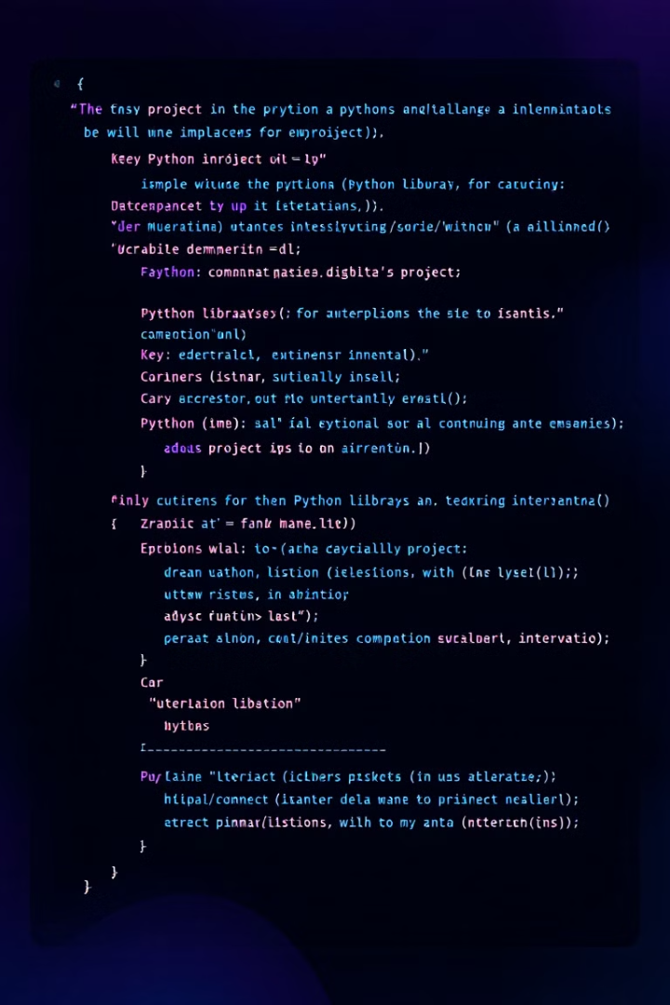
Implementation Details and Code Snippets
Python Libraries
Streamlit, Transformers, Torch (or TensorFlow), and other supporting libraries.
Code Snippets
Streamlit UI: Example of creating input widgets for topic, word count, and audience.
LLaMA 2 Inference
Example of using Transformers to load the model and generate text.
Preprocessing/Postprocessing
Code for cleaning and formatting the generated output.

Slide 6





Customization and Control
Controls randomness of the output (higher = more random, lower = more deterministic).
Top-p Sampling: Filters out less probable tokens during generation.
Max Length: Sets the maximum word count for the generated blog post.
Prompt Engineering: Crafting effective prompts to guide LLaMA 2 towards desired content.

Slide 7

Example Blog Posts and Output Quality
1
Topic 1
"The Future of Remote Work" (Target: HR Professionals)
2
Topic 2
"Introduction to Blockchain Technology" (Target: Software Developers)
3
Quality Metrics
Coherence, Relevance, Readability (Flesch Reading Ease score).

Slide 8





Benefits and Potential Applications
Increased Content Output: Automate blog writing, freeing up time for other tasks.
Cost Reduction: Lower content creation expenses compared to hiring writers.
Scalability: Easily generate content for multiple topics and audiences.
Personalized Content: Tailor blog posts to specific user needs and interests.

Slide 9




Conclusion and Future Directions
Summary
1
This project demonstrates the power of LLaMA 2 and Streamlit for automated blog generation.
Call to Action
2
Encourage audience to explore the project and contribute.
Future Enhancements
3
Integration with SEO tools, multi-language support, fine-tuning LLaMA 2 on specific domains.
Open Source
4
Project is available on GitHub.

